Slide 1
CrimeInsight : A Database Approach to Crime Analysis
By - Ansh Sharma (UE223013)
Abhibhav Sharma (UE223004)
Anurag Kumar Vig (UE223015)
Aayush Kumar(UE223003)

Slide 2

Aim
Our project aims to analyse and get insights of most common crimes in India and see the change in their total number across all states from 2011 to 2020.
This project also aims to spread awareness among the viewers about crime in general, its affects, causes, prevention, punishments, measures taken by the government to curb these crimes .

Slide 3
Table of Contents
01
02
03
04
Introduction
Research and analysis
Definition, Types, Causes,
and Affects etc
Crimes analysed, Graphs and Dashboard
Implementation
Flask ,Queries and Sql/Plsql implementation
Conclusion
Our findings, Measures taken, Prevention, Software used

Slide 4
01
Introduction

Slide 5
What is Crime ?
Definition - Crime, the intentional commission of an act usually deemed socially harmful or dangerous and specifically defined, prohibited and punishable under criminal law.
Crime in layman terms is an offence that harms someone in a physical or mental sense or against the rules and regulation set by the authority of the country.

Slide 6

Type of crimes
1) Violent crime
2) Property crime
3) White-collar crime
4) Organized crime
5) Consensual or victimless crime

Slide 7
Causes of Crime
“Poverty is the mother of crime”
By – Marcus Aurelius
1) Poverty
2) Peer pressure
3) Drugs
4) Politics
5) Religion
6) Background
7) Society
8) Unemployment
9) Unequal rights
10) Unfair system

Slide 8
Affects
1) Loss of property
2) Loss of life
3) Loss of resources
4) Loss of time
5) Spreading of hate
6) Breaks morals and ethics
7) Affects relations
8) Affects reputation
9) Encourages more crime
10) Wastes money
“if you do the crime ,
be prepared to do the time”
By- Jake Knotts

Slide 9
Punishments
Punishment under section 53 ,IPC:-
1) Death punishment
2) Imprisonment for life
3) Imprisonment
4) Forfeiture of property
5) Fine under IPC
6) Solitary confinement
“Punishment is not for revenge but to lessen the crime and reform the criminal”
By- Elizabeth Fry

Slide 10
02
Research and analysis

Slide 11
Crimes analysed
5 Crimes :-
1) Murder
2) Kidnapping and abduction
3) Rape
4) Autotheft
5) Cyber crime

Slide 12
Data Cleaning
Following steps has been done for data cleaning:-
1) Removal of redundant values
2) Normalization of the data
3) Standardization of data
4) Homogeneity of dataset
5) Removal of NULL values
6) Removal of multiple indexes

Slide 13
On to the Dashboard
The dashboard has been used to show the database of crimes we have selected and we can see the data of the crime with respect to the state , year and zone respectively.
We have used 6 graphs for the representation of our data :-
A bar graph
A pie chart
2 line graphs
A geographical map
An area chart
https://public.tableau.com/app/profile/abhibhav.sharma/viz/Crime_Analysis_16996126932620/Dashboard1

Slide 14
“Data is what you need to do analytics , information is what you need to do business”
—John Owen

Slide 15
03
Implementation

Slide 16
Concepts used :-
1) Sql
2) Plsql
3) Flask
4) Postman API

Slide 17
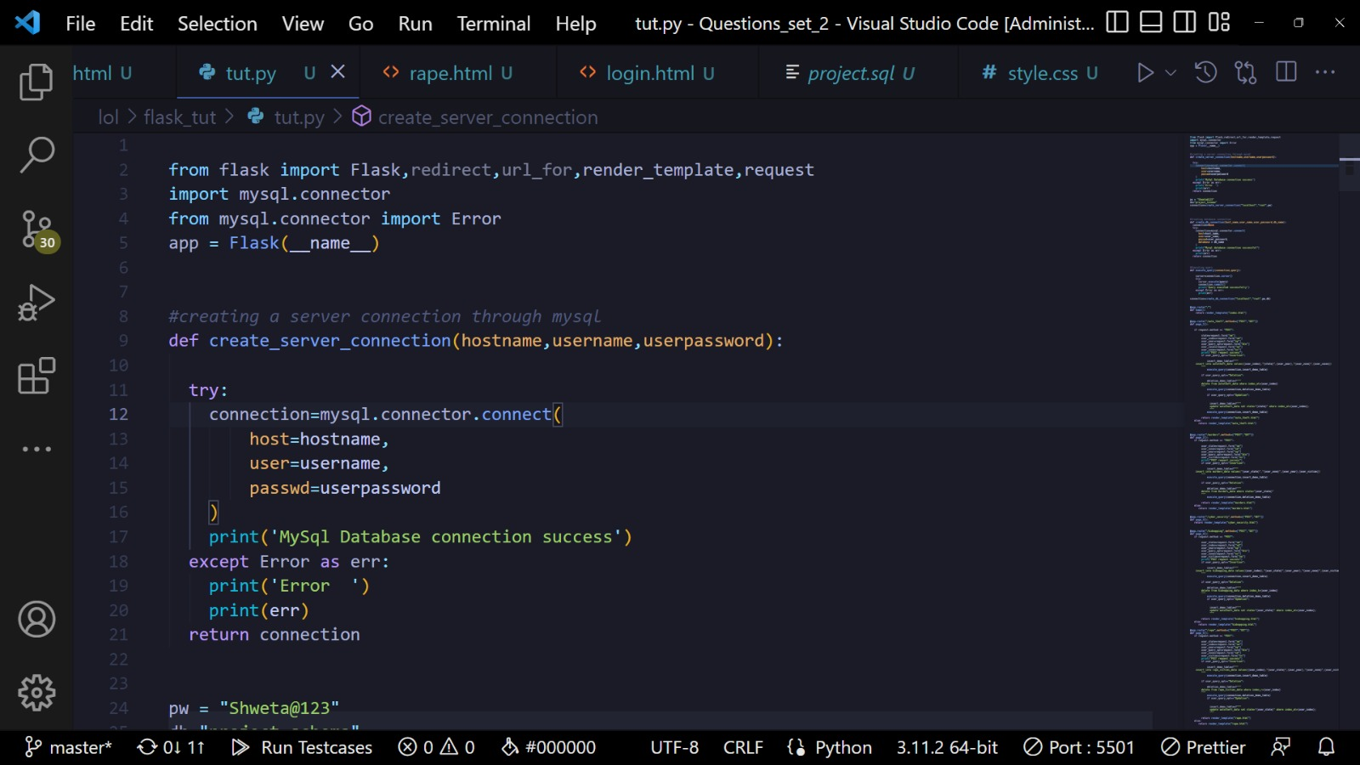
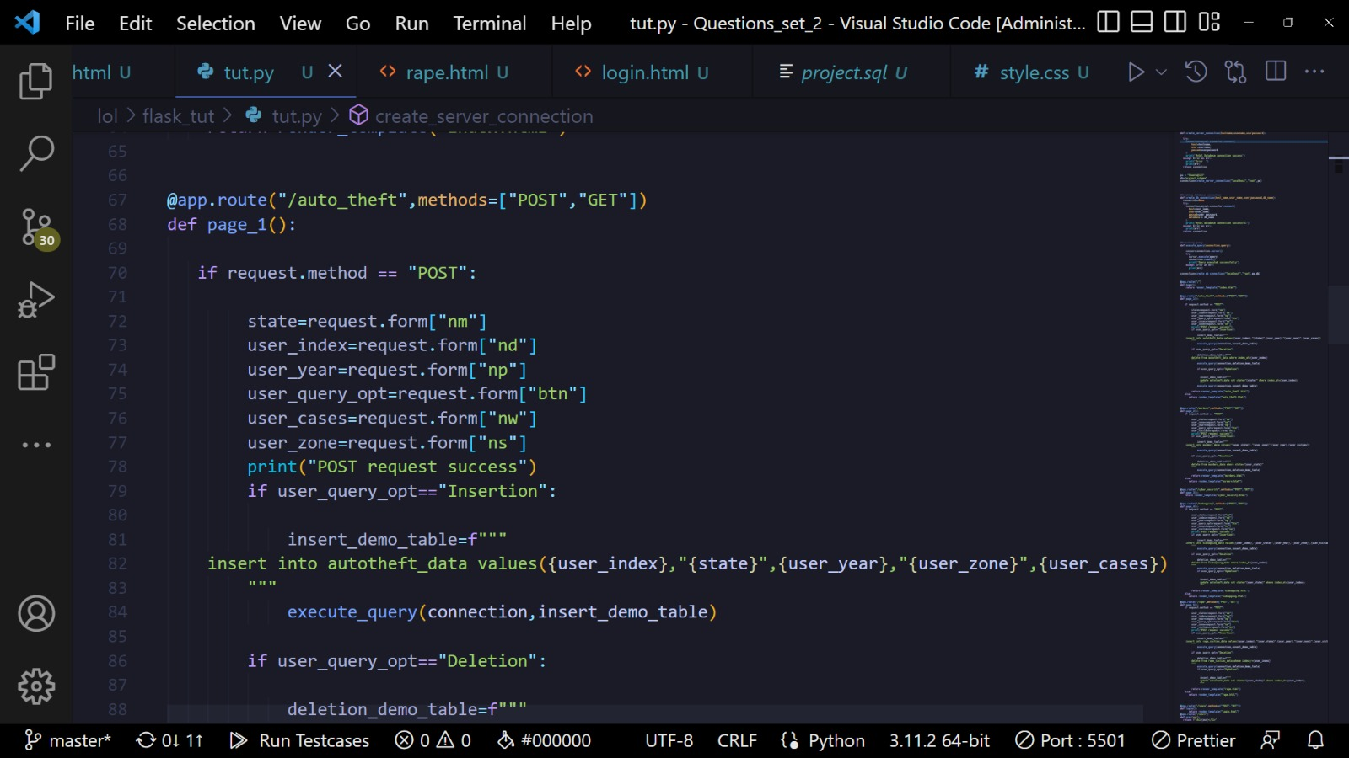
Code Snippet of flask

Slide 18
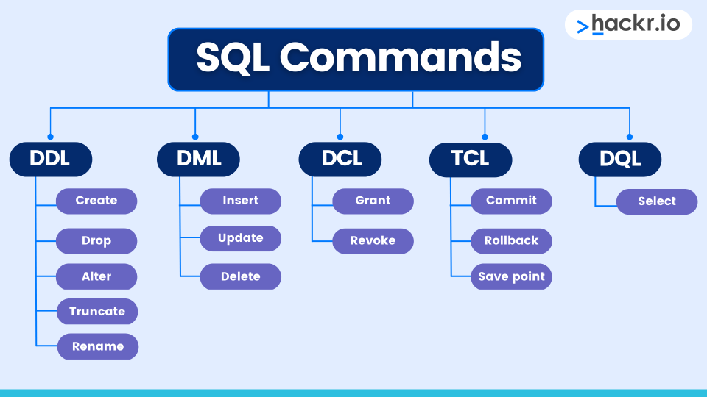
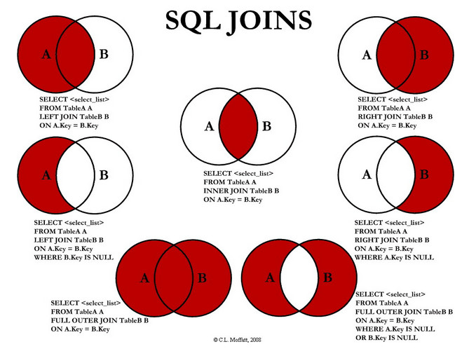
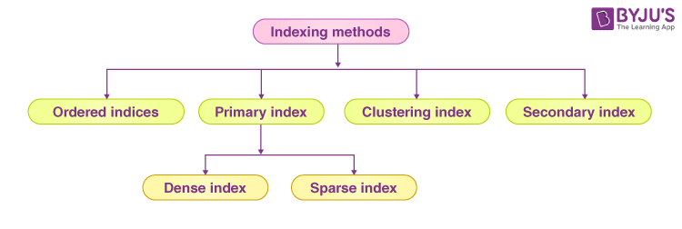
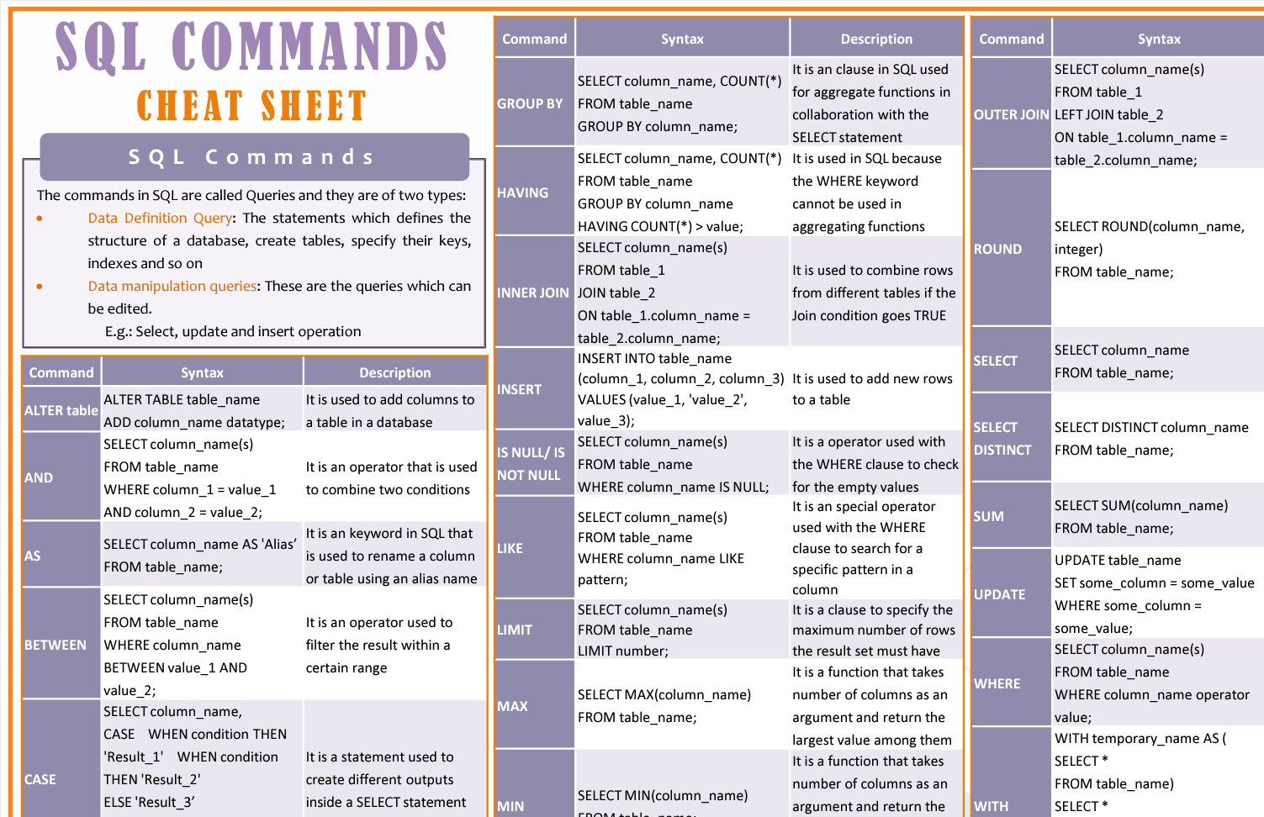
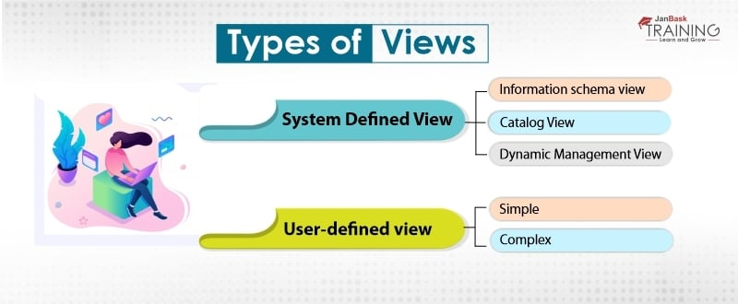
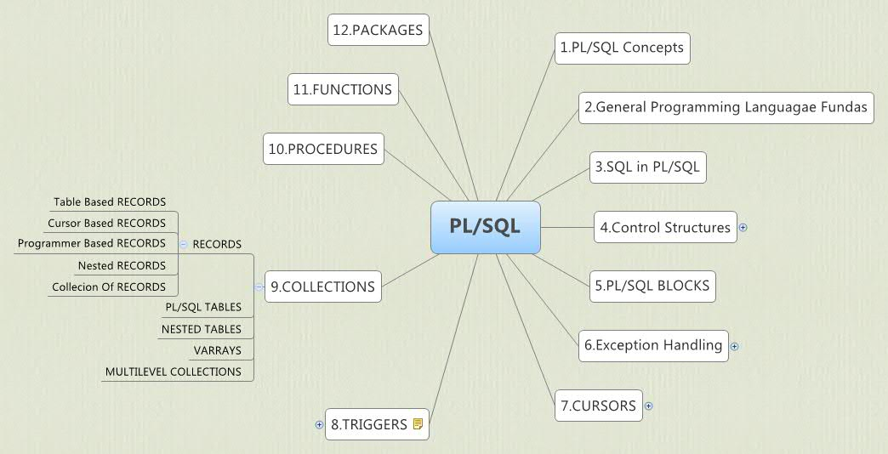
Sql/Plsql Concepts used
Concepts used :-
Sql
1)
2)
4)
5)
6)
7)
8)

Slide 19
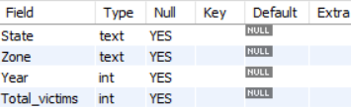
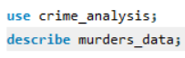
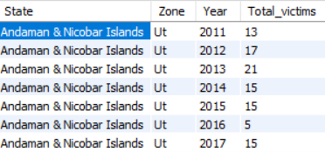
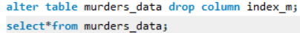
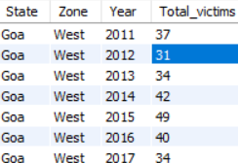
1) Retrieving information about the table.
2) Use of Alter and Drop
3) Finding information about murder victims in western states

Slide 20
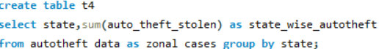
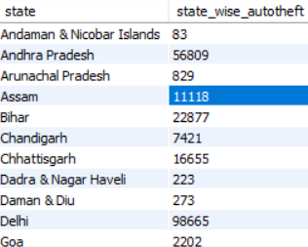
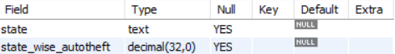
4) Creation of sub tables and use of group by statement
5) Retrieving information about t4

Slide 21
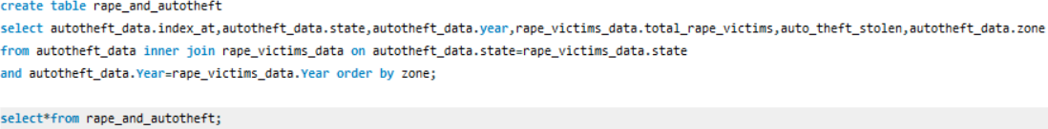
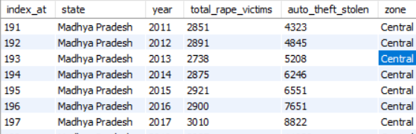
6) Use of inner join, order by to find information about rape and auto theft
7) Dropping table
8) Addition of Primary key

Slide 22
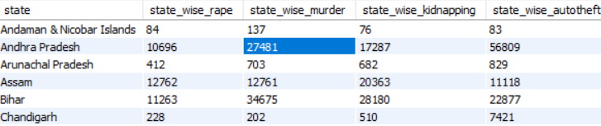
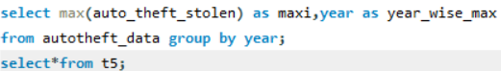
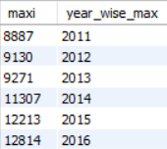
9) Use of joins on sub tables to find aggregate victims of 10 years of different crimes
10) To find year wise max cases of auto theft

Slide 23
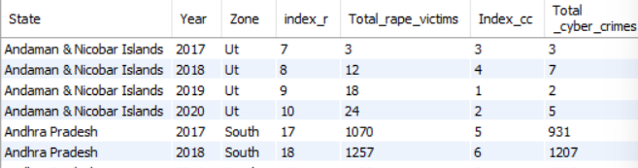
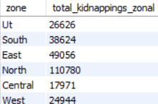
11) Use of Natural join on cyber crime data
12) Finding kidnapping victims zone wise
13) Use of commit

Slide 24
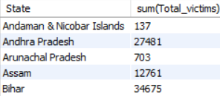
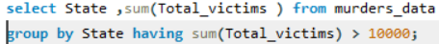
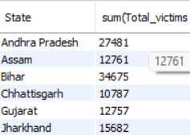
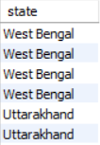
14) State wise murder victims for all years
15) State wise murder victims where total sum is greater than 10000
16) Use of DESC on state

Slide 25
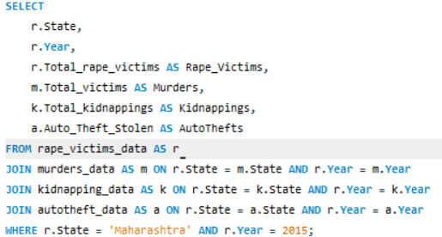
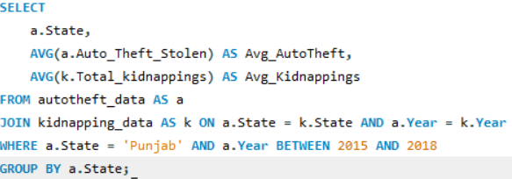
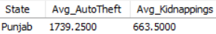
17) Data of victims of different crimes in Maharashtra in year 2015
18) Average cases of auto theft and kidnapping in Punjab from 2010-2019

Slide 26
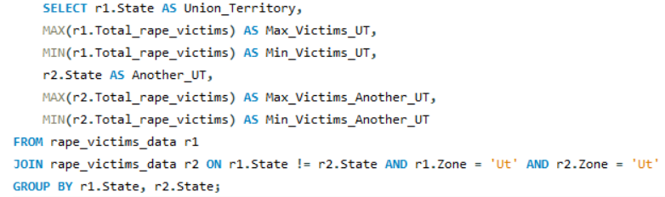
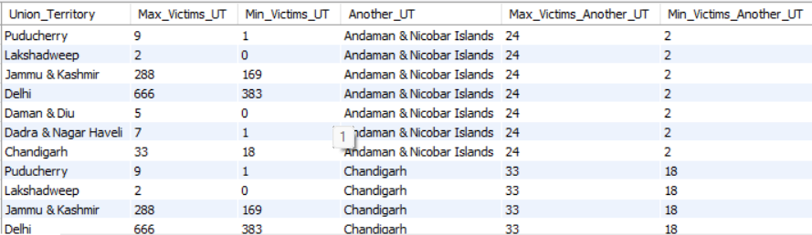
19) Max and min victims of rape in Uts over the 10 years and comparison with other Uts

Slide 27
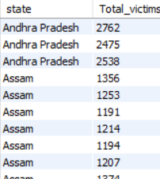
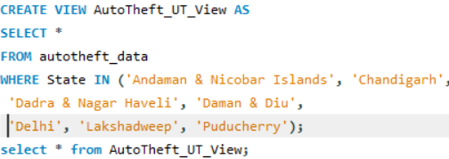
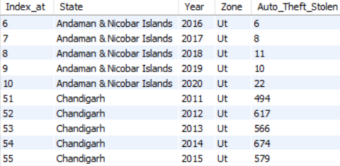
20) State wise murder victims where they are greater than average victims of kidnapping
21) Creation of view for auto theft cases in Uts

Slide 28
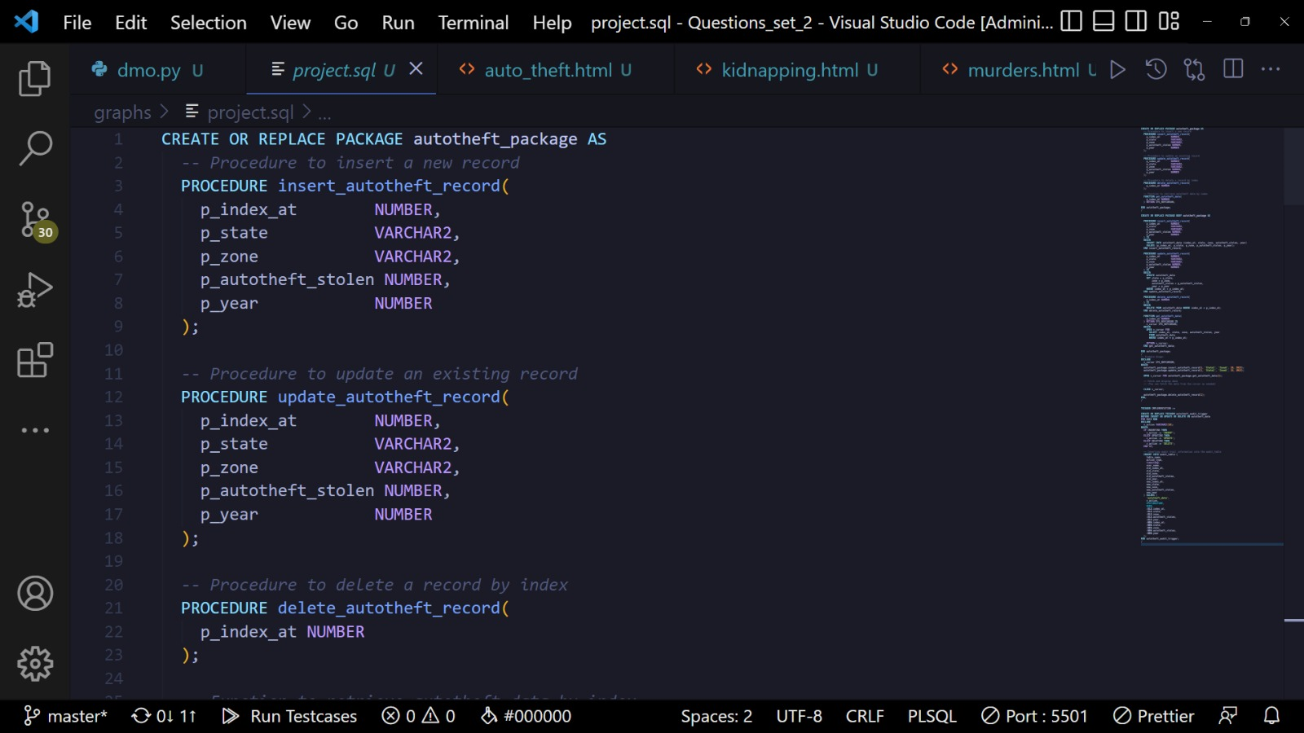
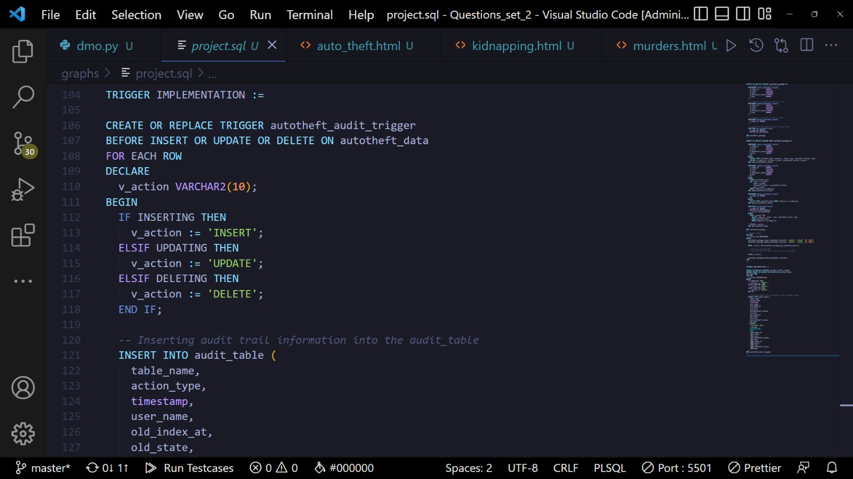
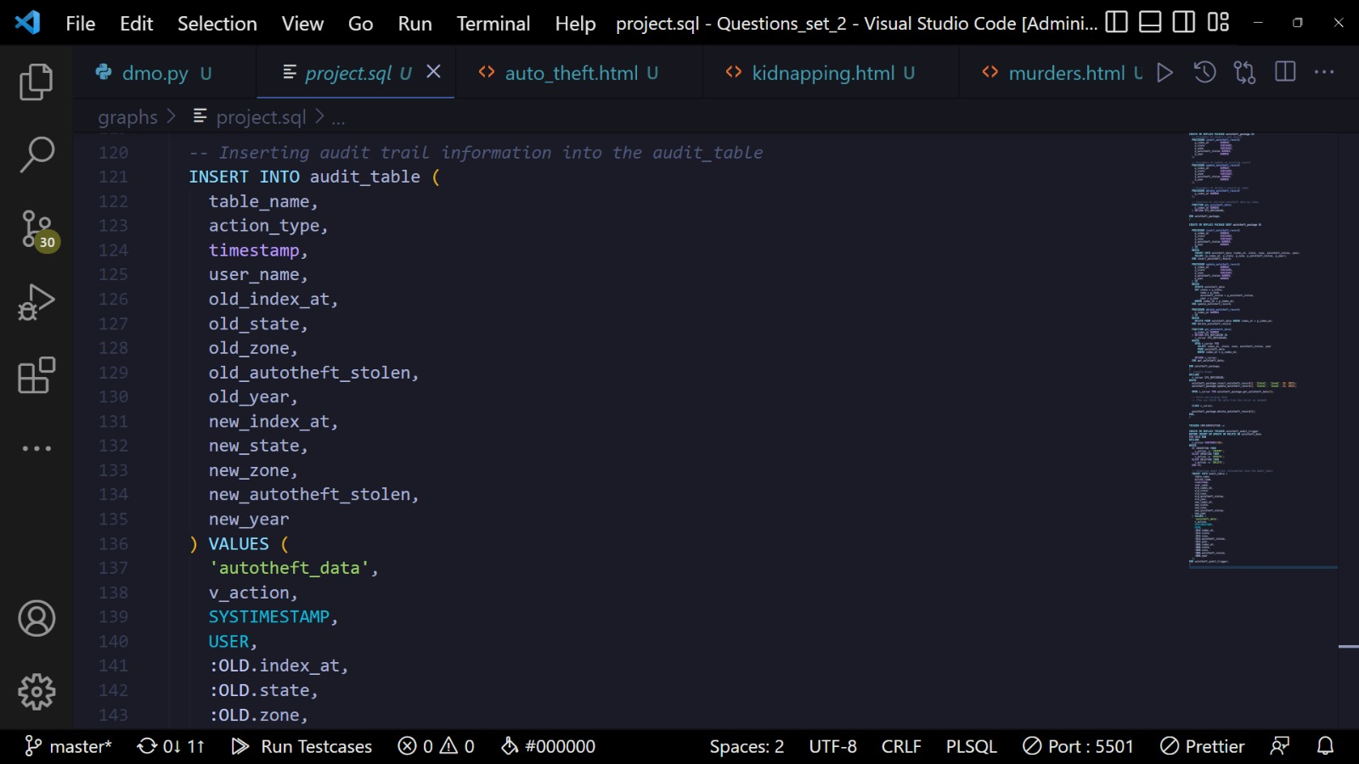
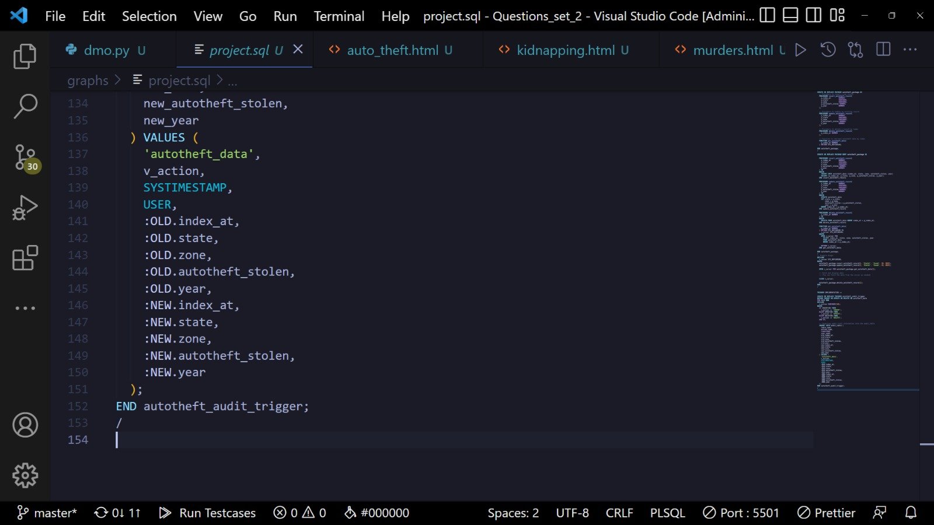
Code snippets of Plsql

Slide 29
Conclusion
04

Slide 30
18,99,467
Total crimes

Slide 31
Our
Findings
1) Most(total) :
Murders:- Uttar Pradesh
Kidnappings:- Uttar Pradesh
Rapes:- Madhya Pradesh
Auto theft:- Maharashtra
2) Kidnappings in UP alone are more than kidnappings in total southern zone.
3) Punjab has 4 times the number of kidnappings in Himachal Pradesh.
4) Delhi has 5 times the auto theft cases in Bihar.
5) Kidnapping is a more common crime than rape.
6) There are more rapes occurring in MP than UP and Bihar combined.
7) West Bengal is the 2nd most rape prone state.

Slide 32
8) Chandigarh records 3 times the total kidnappings in Pondicherry.
9) Chandigarh records the same amount of auto theft as J/k and Himachal Pradesh combined .
10) Himachal records 1400 Rape cases in 10 years while MP records 3000 in 1 year.
11) There are same number of rape cases in North as there are in south ,west and UT combined.
12) There are same number of kidnappings in North as there are in south ,west , east and central combined.
13) Haryana is a more crime prone state than Punjab ,while the latter being more than Himachal Pradesh.
14) Delhi recodes about 1 lakh auto theft cases that is about 5 times than Bihar.
15) West Bengal records about the same number of crimes as the total crimes in other eastern states.
16) Maharashtra records more rape cases than Karnataka ,Kerala and Goa combined.
17) The number of crimes are increasing with years .

Slide 33
File of Crimes (Max)
 | State | Year | Zone
Murder | Uttar Pradesh | 2010 | North
Rape | Madhya Pradesh | 2020 | Central
Kidnapping | Uttar Pradesh | 2020 | North
Autotheft | Maharashtra | 2020 | West

Slide 34
Crime Prevention
1) Treat violence as a public health concern
2) Localise programmes
3) Focus on hotspots
4) Avoid repressive policies
5) Increase employement
6) Focus on gun control
7) Learn from history
8) Keep in mind the impact of drugs

Slide 35
Measures taken by the government
Modernization of Police Force: Efforts have been made to modernize and equip the police force with advanced technology and training to enhance their efficiency and responsiveness.
National Crime Records Bureau (NCRB): The NCRB regularly publishes crime statistics and reports, providing valuable data for policymakers to understand crime patterns and trends. This information helps in devising targeted strategies.
Criminal Law Amendments: The government has introduced amendments to criminal laws to address emerging challenges. For example, changes in laws related to sexual offenses, cybercrimes, and child protection have been implemented to strengthen legal frameworks.
Technology Integration: Increased use of technology in law enforcement, such as the introduction of CCTVs, data analytics, and crime mapping, has been emphasized to improve surveillance and investigation.
Community Policing Initiatives: Community policing programs aim to enhance police-community relations, increase public trust, and involve local communities in crime prevention efforts.
Fast-Track Courts: Specialized courts and fast-track procedures have been introduced to expedite the legal process, particularly in cases of heinous crimes and crimes against women.
Strengthening Cyber security: With the rise of cybercrimes, the government has focused on strengthening cyber security measures, including the establishment of specialized cybercrime units.
Juvenile Justice Reforms: Amendments to juvenile justice laws have been made to address concerns related to juvenile offenders, ensuring a balance between rehabilitation and accountability.

Slide 36
Resources / Software used
Kaggle – For retrieving data
Vscode – For python, css and javascript
Sql workbench – For queries
Tableau – For creation of dashboard
Slidesgo – For presentation

Slide 37

Thanks!
Do you have any questions?

